Slide 1
Classification

Slide 2
Classification vs. Regression vs. Clustering
Classification – model (can also be called a classifier) predicts a categorical label
Ex: You are given an image. You have to predict whether it is a cat image or a dog image.
Regression – model predicts continuous-valued function, or ordered value
Ex: Prediction or forecasting of sales data.
Clustering – Unsupervised learning
Grouping of things based on similarity or dissimilarity of attributes.
Ex: Creation of severity clusters and hot spots during the Covid-19 pandemic.
Based on high and low footfall in the areas with patients for sneezing, coughing and fever.

Slide 3
Classification and Clustering
Let’s take the example of T-shirt store.
Problem 1:
Salesman gets to know height and weight of the customer who comes in. And he has to classify this customer for a t-shirt size.
(height, weight, age) --> (t-shirt size as in small, medium, large)
Problem 2:
You open a new store in some part of the world. And you collect data about people’s age, height and weight.
As a store owner, you would like to know how many groups of t-shirts sizes should be there and what are those t-shirt sizes.
As in: xs, s, m, l, xl (so on, so forth)

Slide 4
General Architecture of Classification Model
Classification:
training data + testing data --> classifier <-- predictions (labels)
Training – training set
Testing – test set (validation)
Accuracy measurement of classification
Steps involved in building a classifier:
Step 1: Collect the data.
As in from the client. Or through a survey or study.
Step 2: Split the data into training set and test set.
Step 3: As part of training: You do data preprocessing and model selection.
Step 4: Model Evaluation on Test data set.

Slide 5
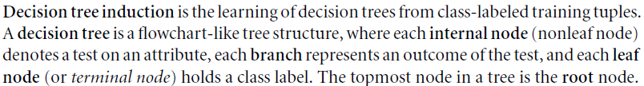
Decision Tree Induction

Slide 6
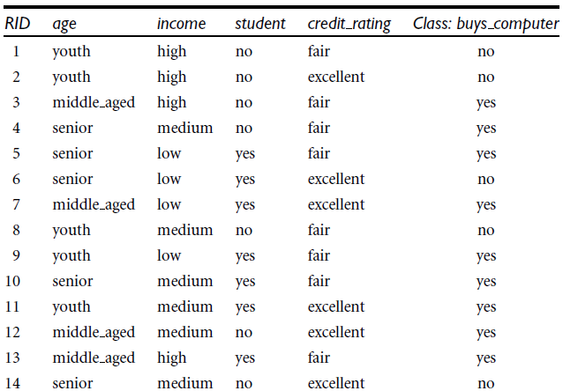
Decision Tree Induction

Slide 7
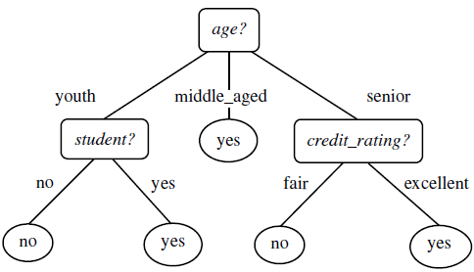
Decision Tree Induction

Slide 8
Decision Tree Induction
Attribute Selection Measures (or Splitting Rules)
Information gain (entropy)
Gain ratio
Gini Index

Slide 9





Attribute Selection Measures
Information Gain
Expected information needed to classify a tuple in D:
If we select attribute A for partition, then the information
we still need for classification is given by:

Slide 10

Attribute Selection Measures

Slide 11

Attribute Selection Measures

Slide 12

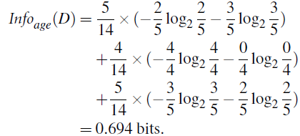
Attribute Selection Measures

Slide 13
Attribute Selection Measures

Slide 14
Attribute Selection Measures

Slide 15
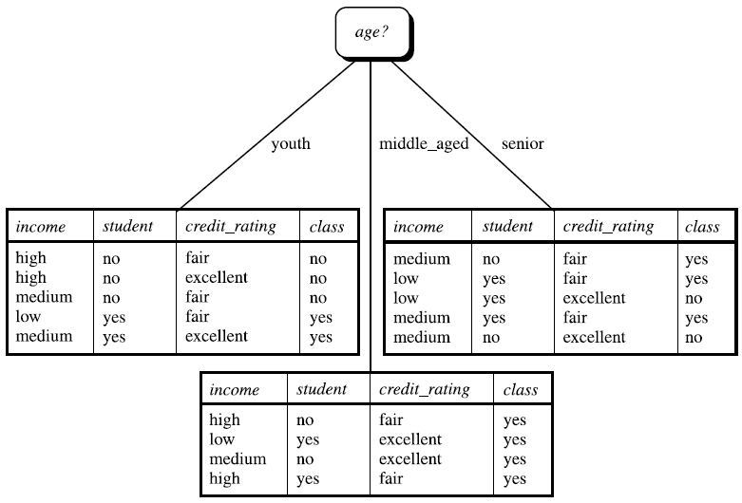
Attribute Selection Measures

Slide 16


Attribute Selection Measures

Slide 17
Attribute Selection Measures

Slide 18
Attribute Selection Measures
= 0.468 (?)

Slide 19

Attribute Selection Measures

Slide 20

Attribute Selection Measures

Slide 21
Attribute Selection Measures
Consider each attribute and all possible split. Ex. Let’s consider attribute income. Find Gini index of the split into subset {low, medium} and {high}

Slide 22
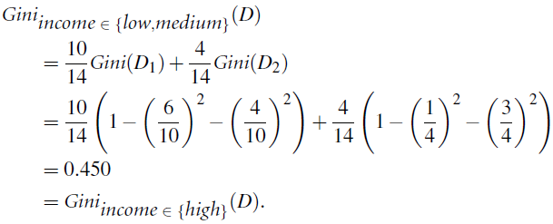
Attribute Selection Measures
Consider each attribute and all possible split. Ex. Let’s consider attribute income. Find Gini index of the split into subset {low, medium} and {high}
Fill correct values here:

Slide 23
Thank You!

